Slide 1
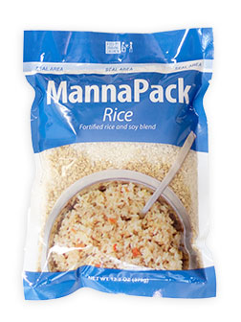
Hunger is the world’s largest solvable problem
Our Mission
Until ALL Are Fed

Slide 2
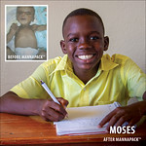
Hunger is the world’s largest solvable problem
345 Million are facing acute food insecurity – up from 135 million in 2019
50 Million in 45 countries are teetering on the edge of famine
Between 7,800 and 15,000 die daily – up from 6,200 in 2019
11 people die every minute
Half are children / 60% are women/girls
The 4 C’s – conflict, climate, covid 19, costs
Where is the Hope?
* All figures - World Food Program

Slide 3
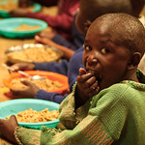
Feeding Starving Children - Connected Non-Profits, each focused on what they do best
Feed My Starving Children
Feed the Need STL
Partner NGO’s
National Non-profit founded in 1987
Pioneering Food Formulas
Hand & Machine packed meals
Fixed & Mobile sites
Local Non-profit founded in 2007
8.3M meals provided
25,000 volunteers/22,448 kids fed
Transitioning to Queeny Park
70 Countries
99% Intended Distribution
Schools/Orphanages
Medical Clinics/Feeding Programs
*NGO: Non-governmental organization

Slide 4
Feeding Starving Children - Connected Non-Profits
Partner NGO’s
Feed My Starving Children
Feed the Need STL
Global
70 Countries
99% Intended Distribution
Schools/Orphanages/Medical Clinics/Feeding Programs
Operation Food Search
National Non-profit founded in 1987
Pioneering Food Formulas
Hand & Machine packed meals
Fixed & Mobile sites
Local Non-profit founded in 2007
7.3M meals provided
25,000 volunteers/22,448 kids fed
Transitioning to Queeny Park
Local
Local Non-profit founded in 1981
330 Community Partners
27 Missouri and Illinois Counties
200,000 fed monthly
*NGO: Non-governmental organization

