Slide 1
Welcome to Feed the Need STL
FeedTheNeedSTL.org

Slide 2
We are so glad you came to pack with us today
FeedTheNeedSTL.org

Slide 3
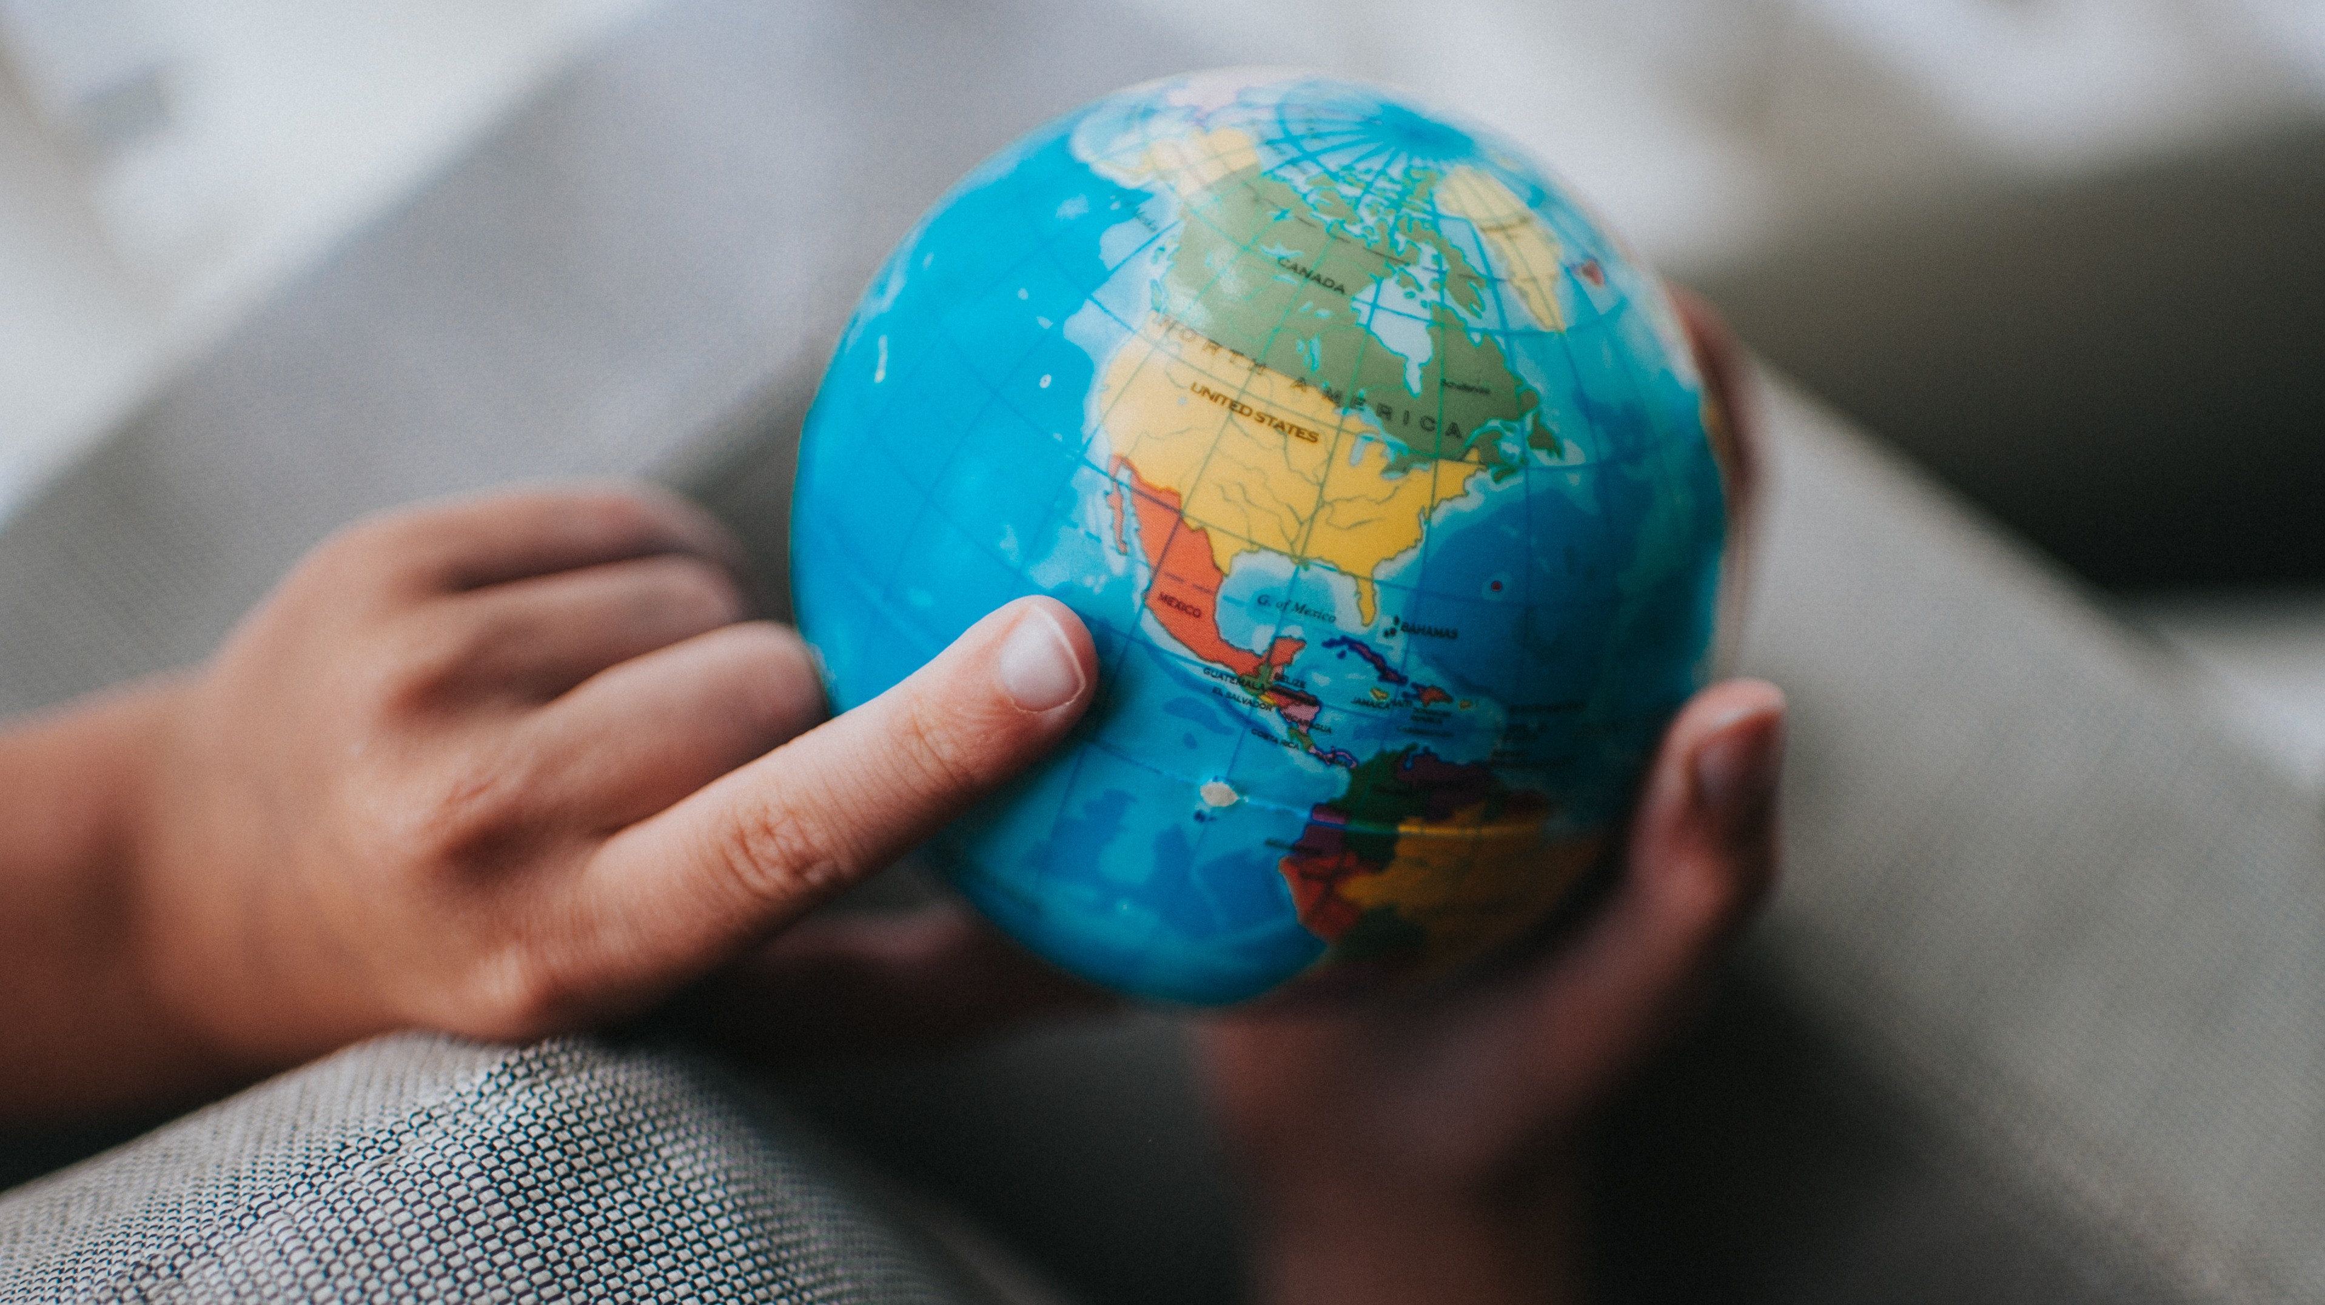
The need for food is great around the world…and at home

Slide 4
Did you know that worldwide, 1 in 10 children work to earn a living instead of going to school?

Slide 5
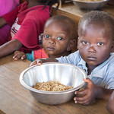
Haiti’s need is great and it’s right in our backyard
Food access has been cut-off for many
3 million children are in danger of starvation
Nearly half of all the country survives on 1 meal per day

Slide 6
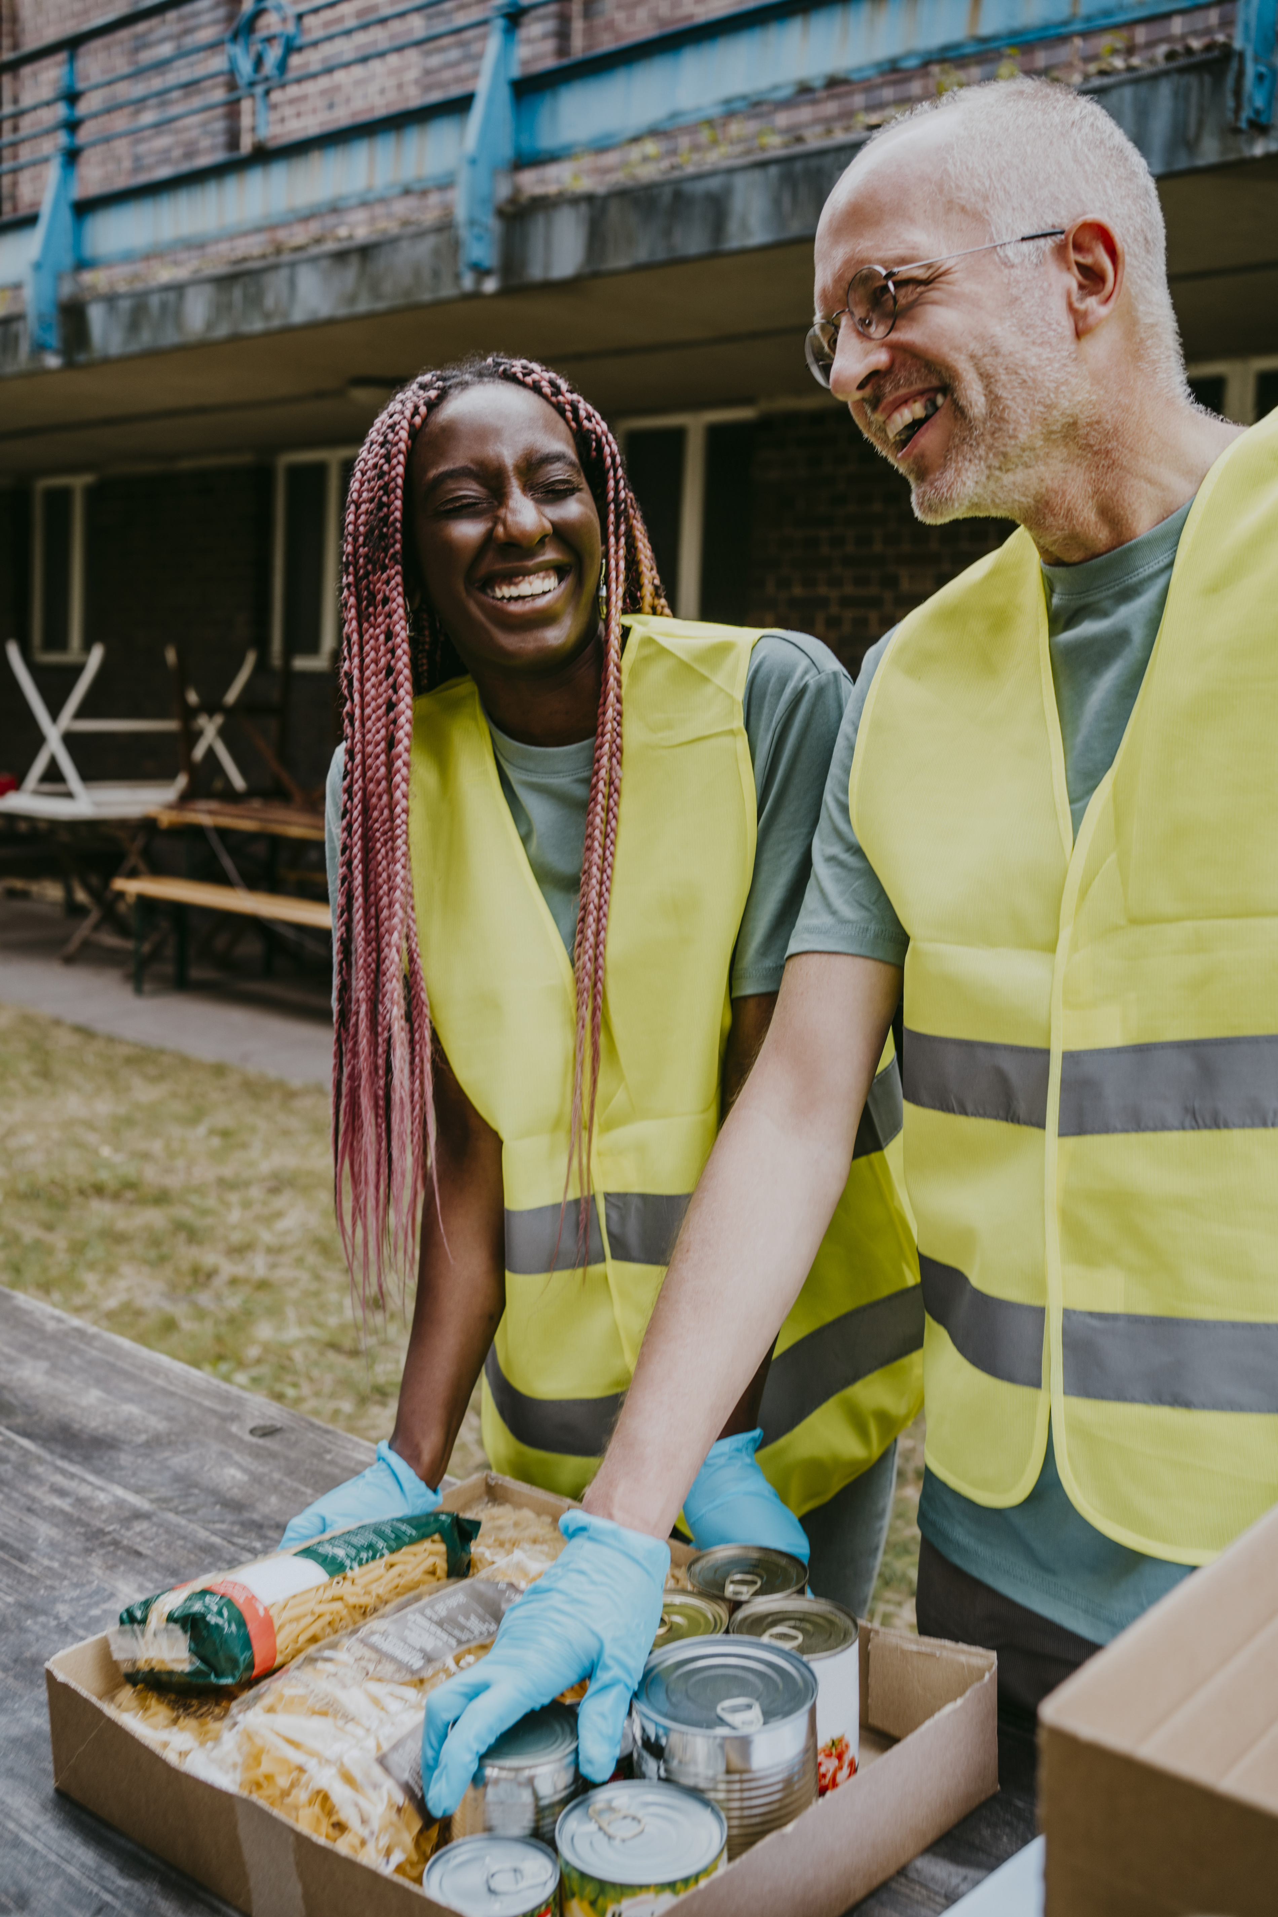
Even In the U.S., 17.3% of households with kids are food insecure; 1 in 6 kids are at risk of hunger

Slide 7
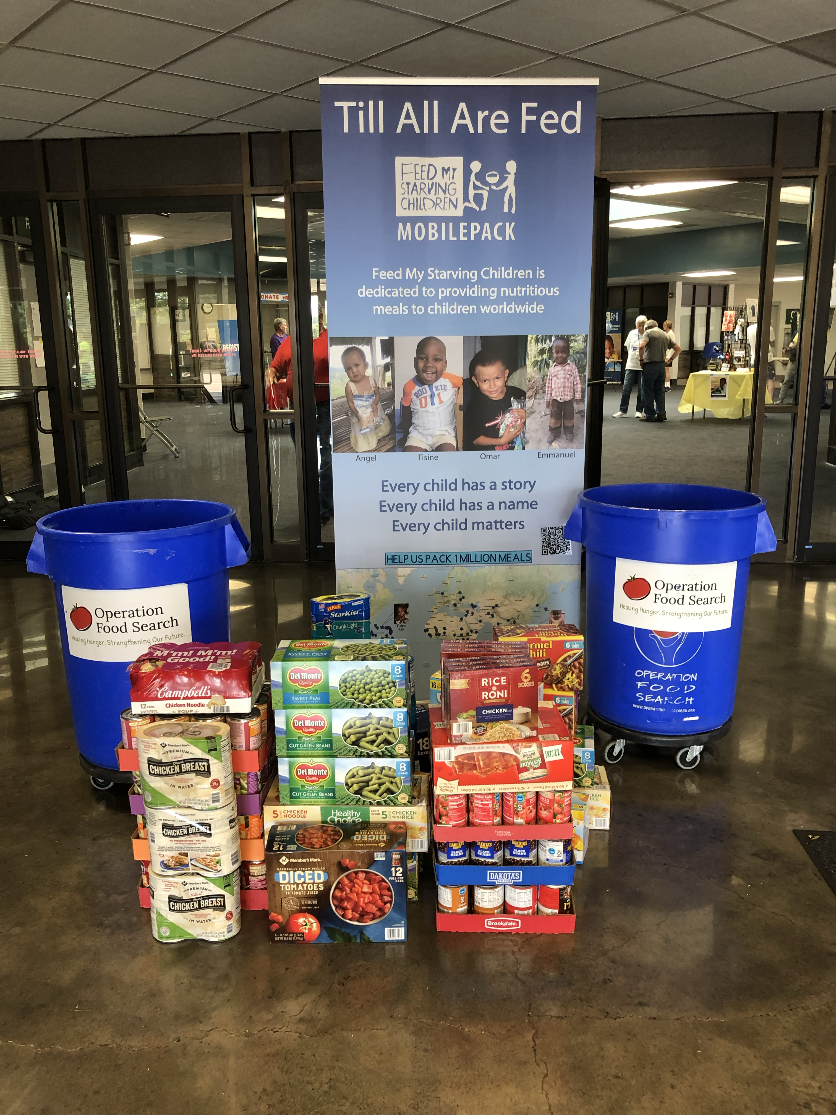
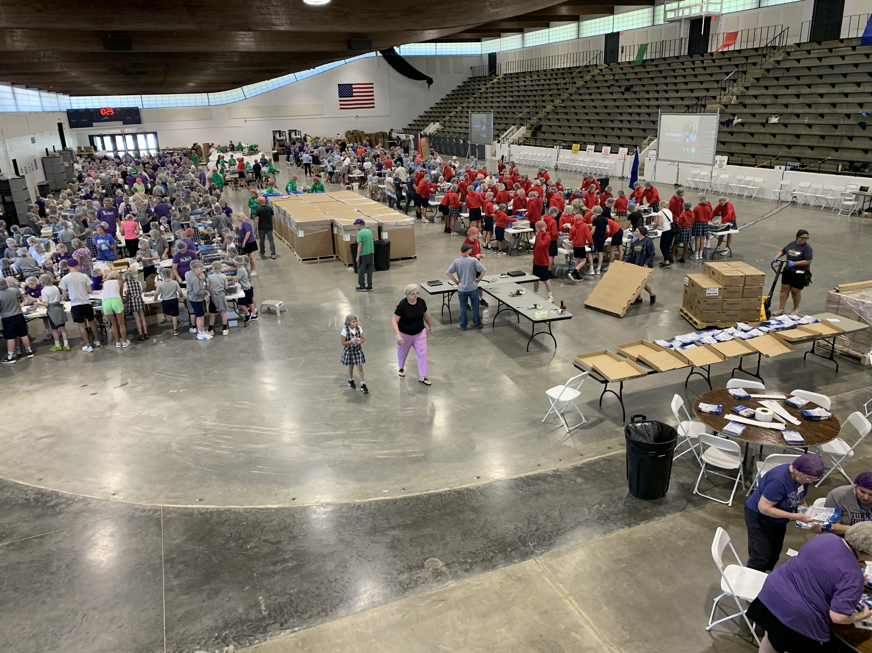
Working together we can make a difference!

Slide 8
How do we pay for all this food?
FTNSTL raises money year round to pay for the food we pack…
Money comes from your generous donations
Downstream partners pay only for freight
The hungry and starving people pay nothing

Slide 9
Donate today and receive an awesome sticker or wristband

Slide 10
It’s easy to donate, just scan and click!

Slide 11
Let’s play some MobilePack trivia while we get started

Slide 12
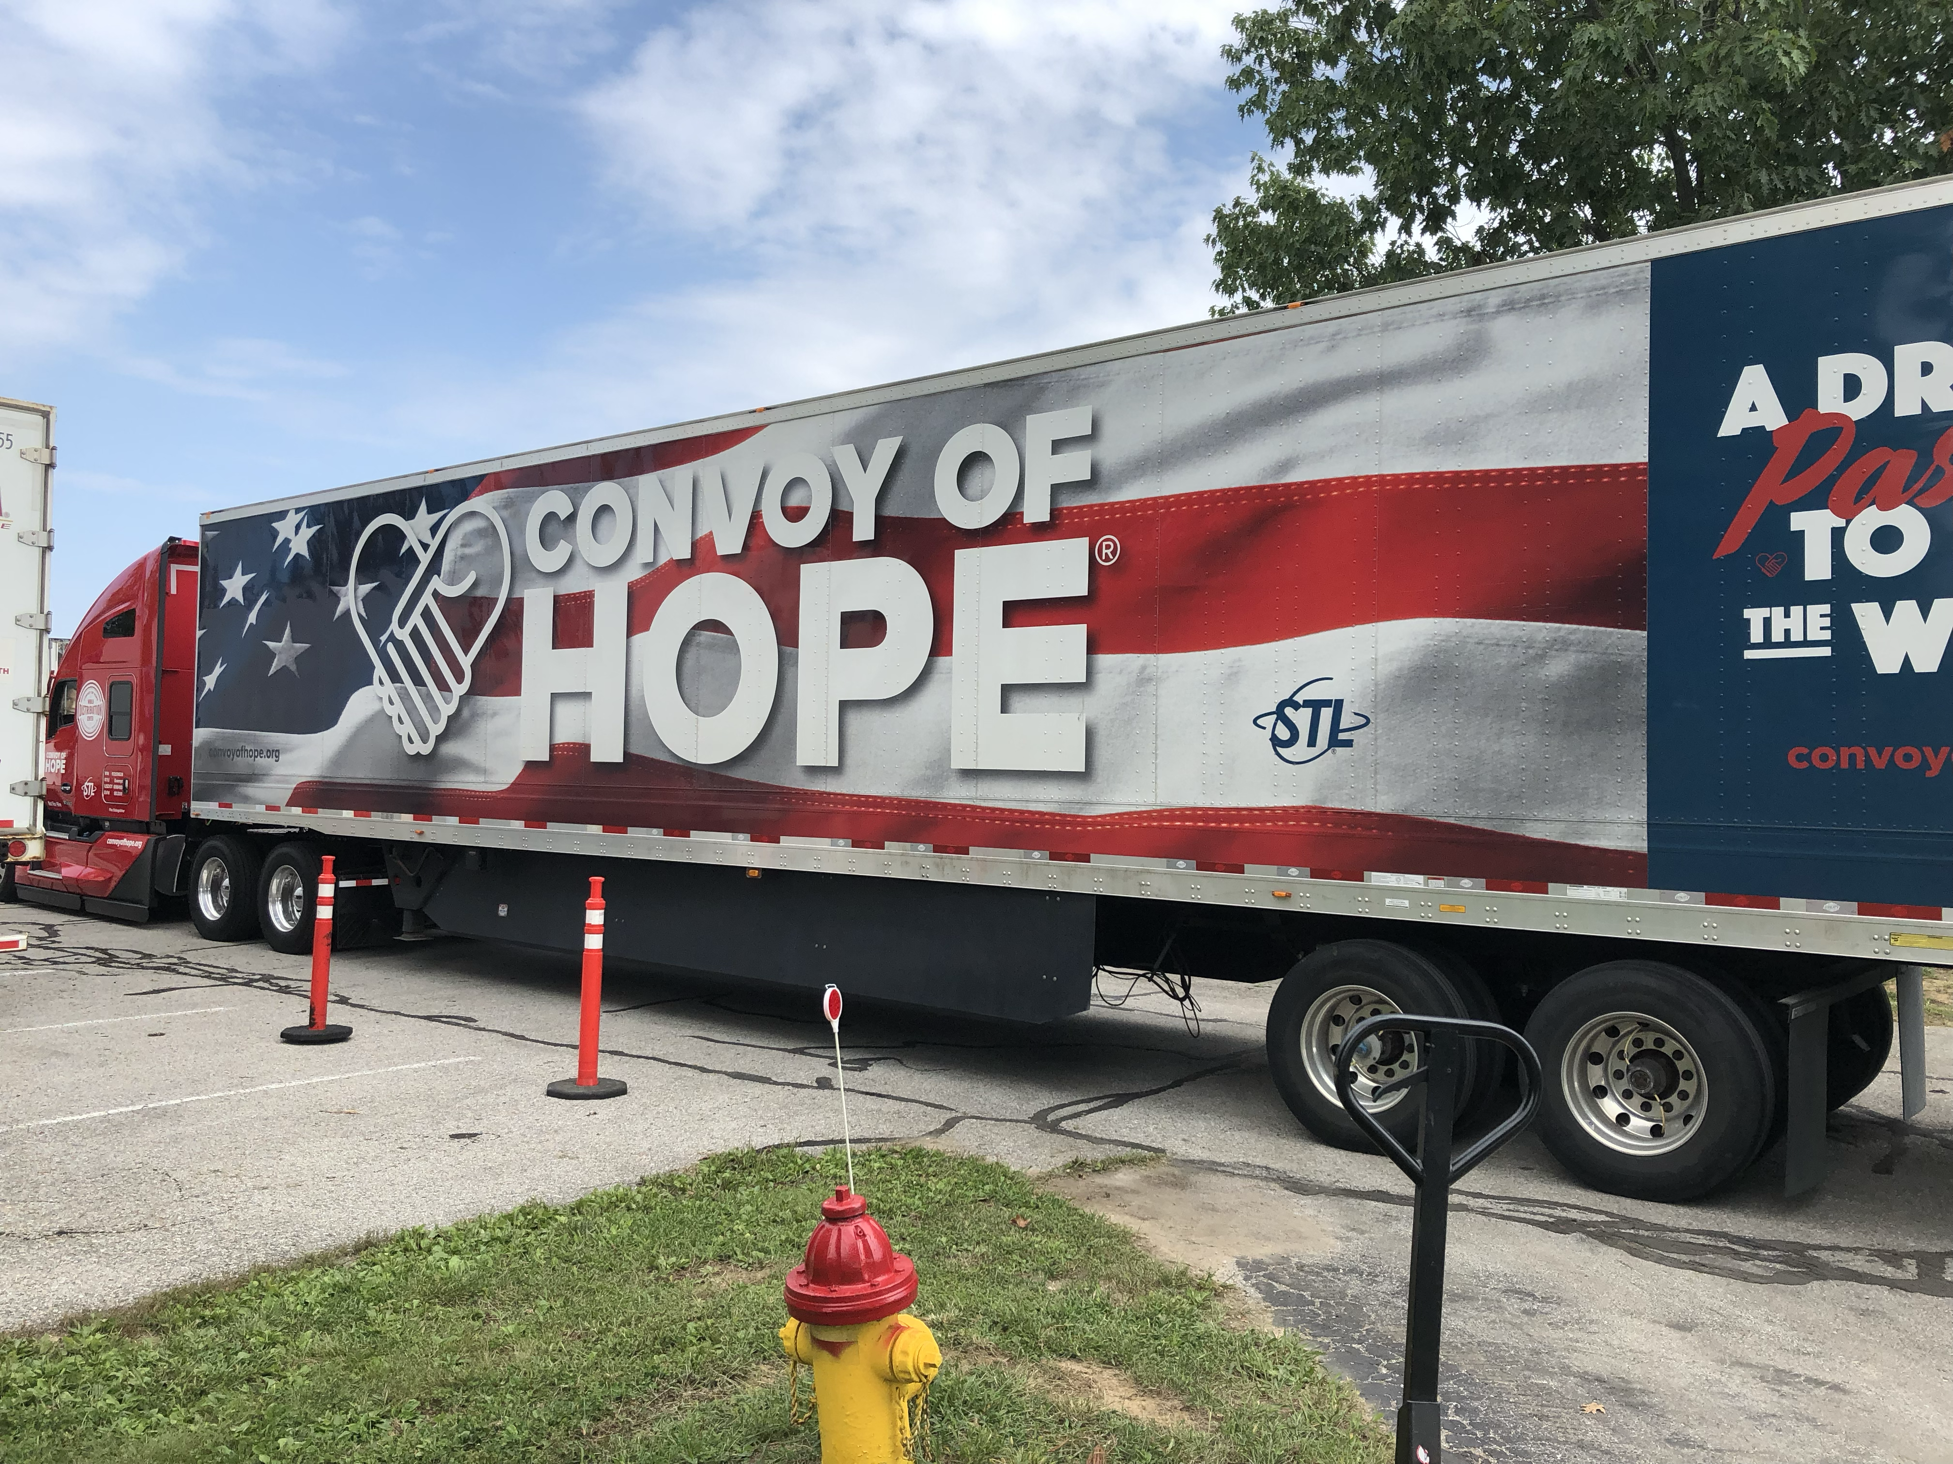
How many meals will Feed My Starving Children Pack this year? 250 Million 300 Million 400 Million

Slide 13
How many meals will Feed My Starving Children Pack this year?
Feed My Starving Children will pack more than 400 million meals in 2024
250 Million
300 Million
400 Million

Slide 14
How many meals will the average person pack today?
100 Meals
200 Meals
300 Meals

Slide 15
How many meals will the average person pack today?
100 Meals
200 Meals
300 Meals
The average person packs about 1 box or 216 meals…
Each box costs about $63

Slide 16
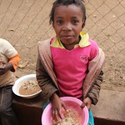
Which country has received Feed the Need Meals packed in the past?
Philippines
Haiti
Yemen
Sudan
All of the above

Slide 17
Which country has received Feed the Need Meals in the past?
Feed the Need Meals have been sent to more than 15 countries
Philippines
Haiti
Yemen
Sudan
All of the above

Slide 18
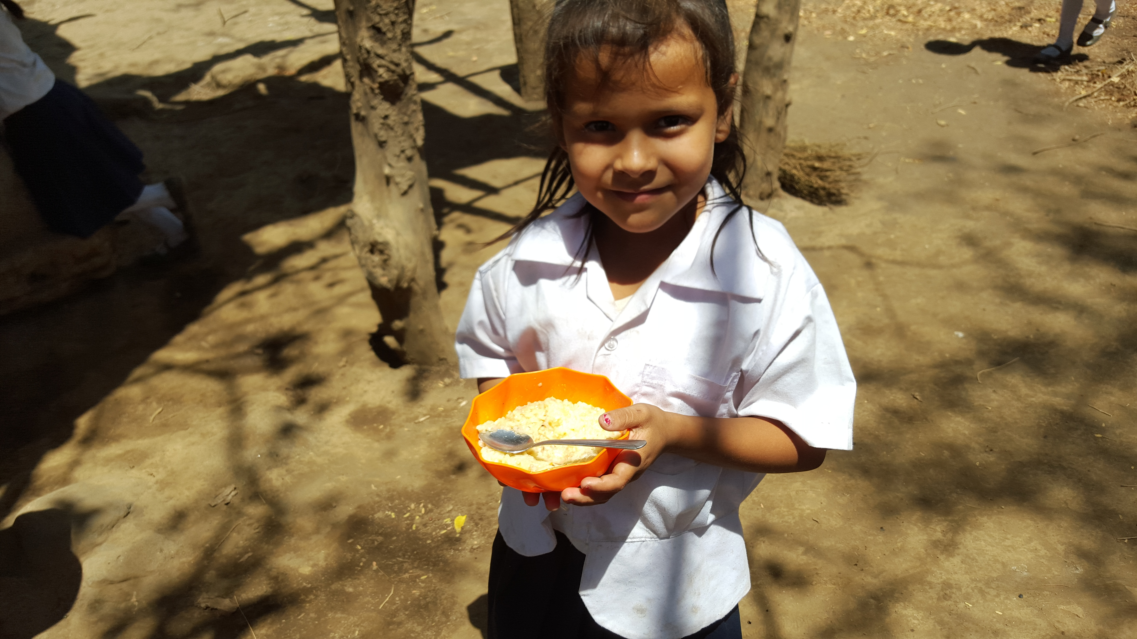
How many kids have been fed by Feed the Need STL since 2007?
10,000 kids
15,000 kids
30,000 kids

Slide 19
How many kids have been fed for a year by Feed the Need STL since 2007?
Feed the Need Meals have fed almost 30,000 kids daily for a year
10,000 kids
15,000 kids
30,000 kids

Slide 20
What percentage of meals that you pack today will successfully reach its target?
50% plus
80% plus
99% plus

Slide 21
What percentage of meals that you pack today will successfully reach its target?
99.2% of Feed My Starving Children meals reach their target!
50% plus
80% plus
99% plus

Slide 22
How much does it cost to produce 1 meal?
30 cents
50 cents
100 cents

Slide 23
How much does it cost to produce 1 meal?
Each meal we produce costs less than 30 cents
30 cents
50 cents
100 cents

Slide 24
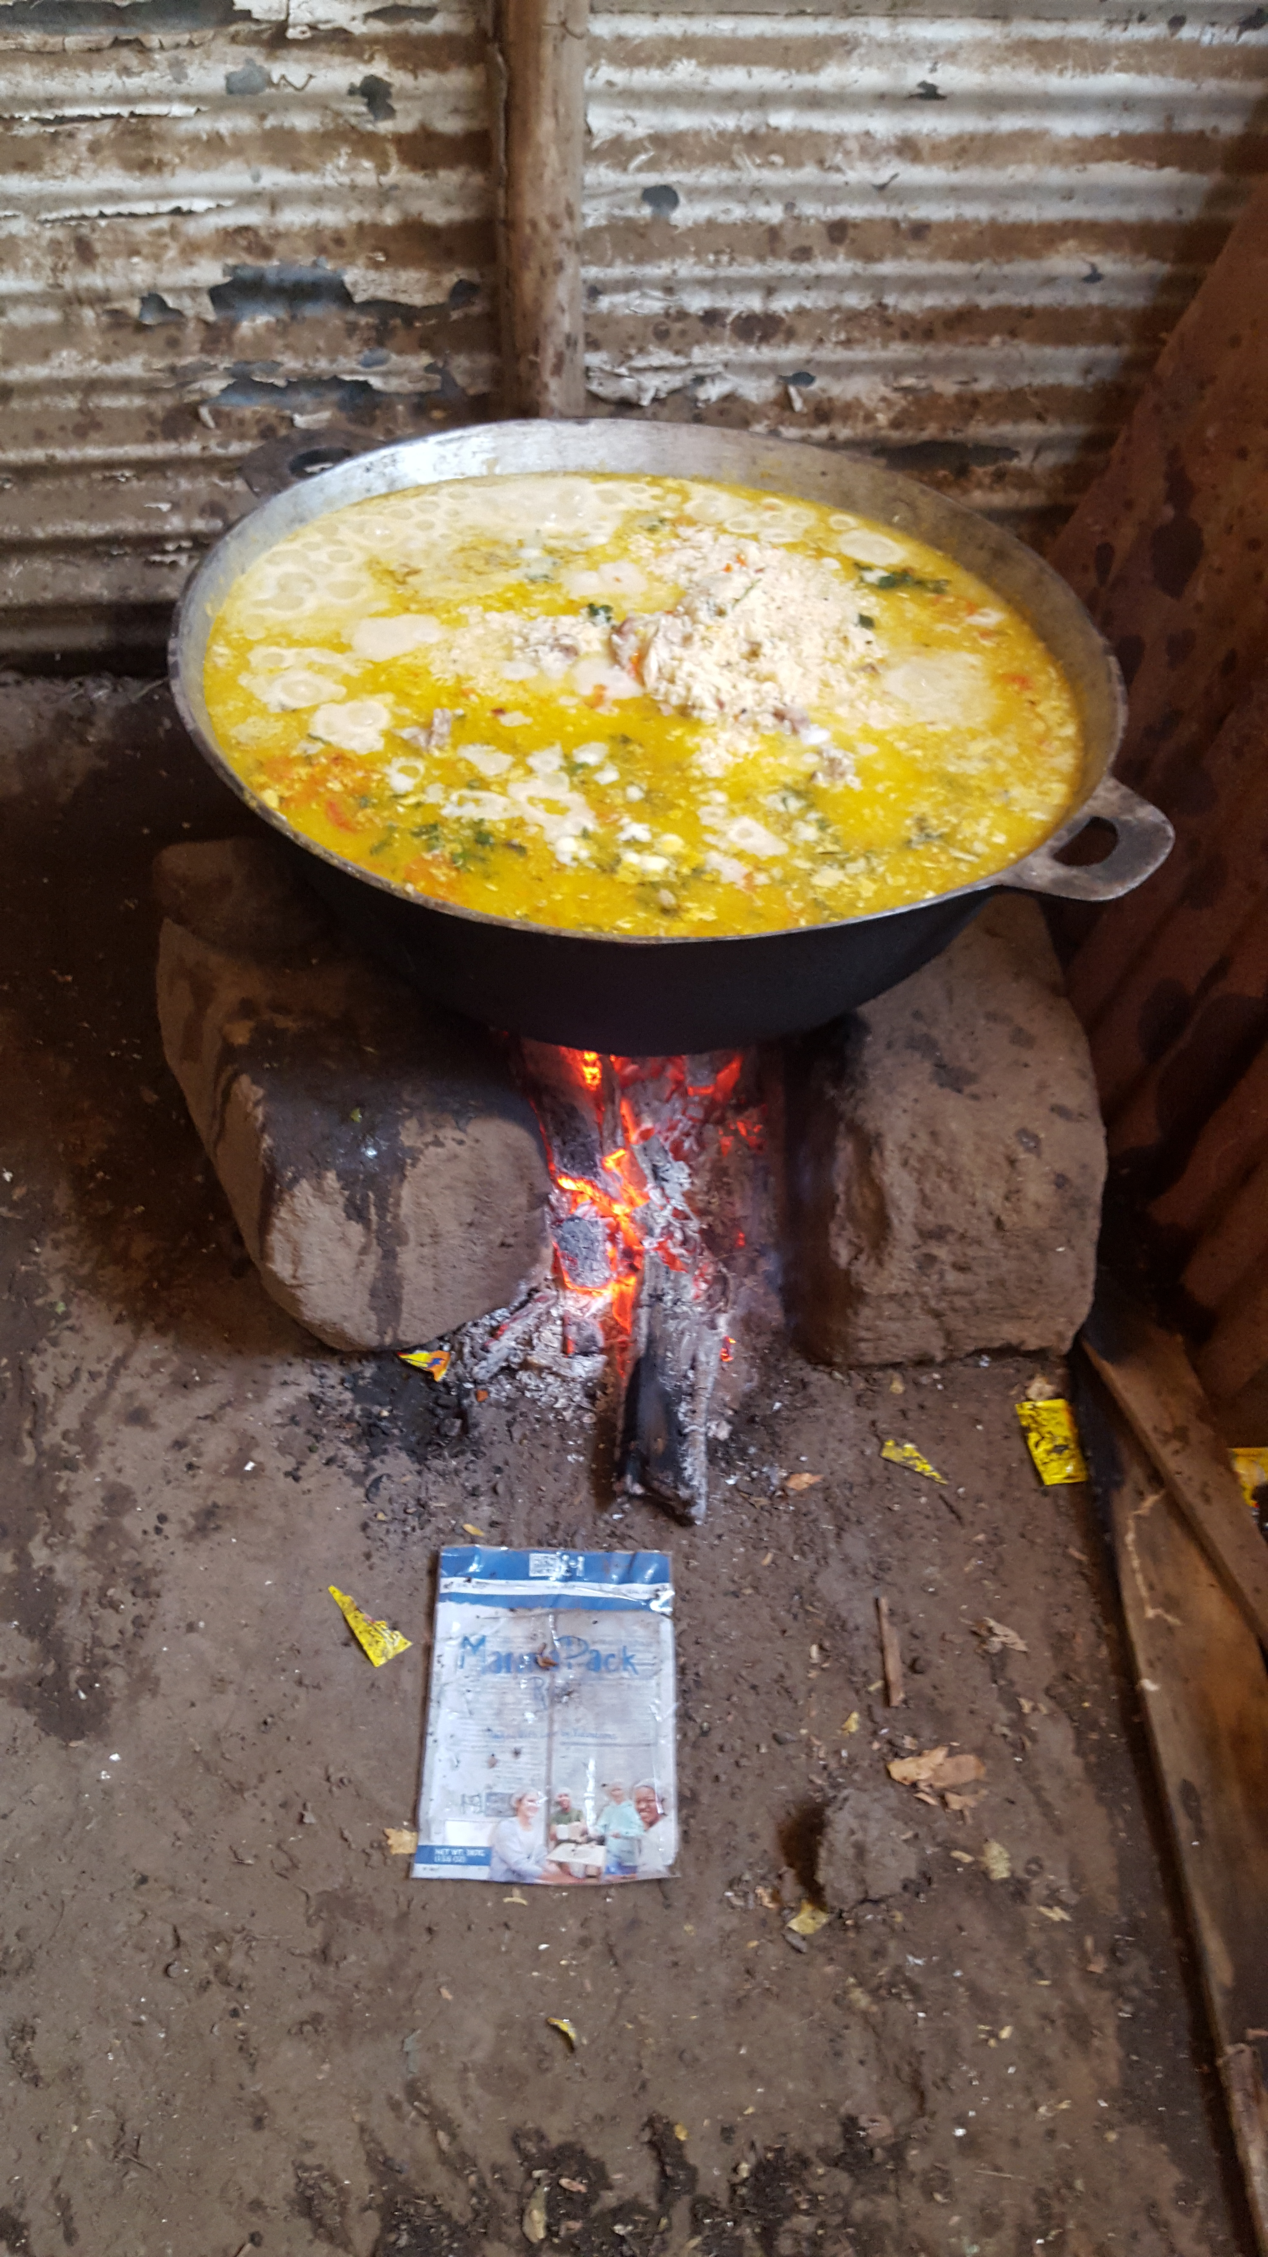
How many meals are in each bag you pack today?
1 Meal
6 Meals
10 Meals

Slide 25
How many meals are in each bag you pack today?
Each bag holds 6 -1 cup meals; it costs less than $2 for 6 meals
1 Meal
6 Meals
10 Meals

Slide 26
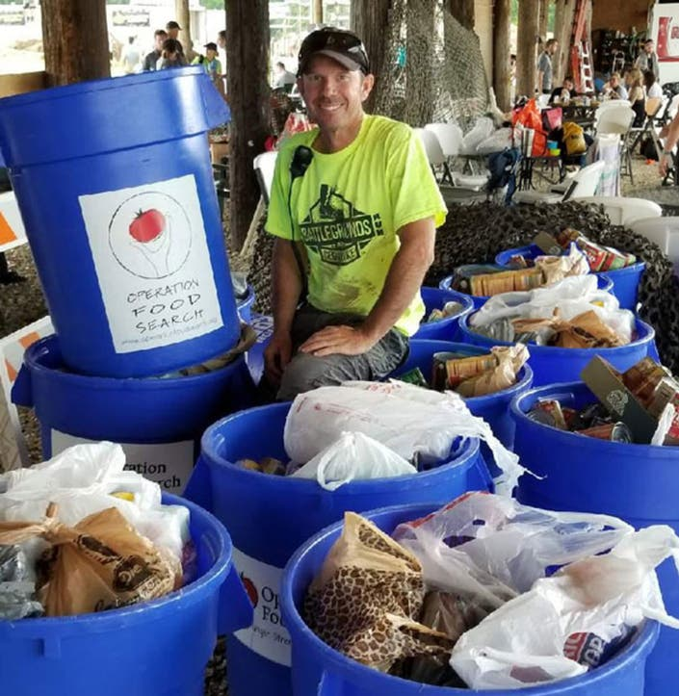
How many barrels of food will we collect for Missouri and Illinois food banks this year?
10 barrels
20 barrels
40 barrels

Slide 27
How many barrels of food will we collect for Missouri and Illinois food banks this year?
We will collect 40 barrels or about 2.5 tons of food, feeding more than 1,250 neighbors a nutritious meal
10 barrels
20 barrels
40 barrels

Slide 28
Check out the Marketplace Unique, handcrafted items Profits fund more meals Provide sustainable jobs Pay a living wage

Slide 29
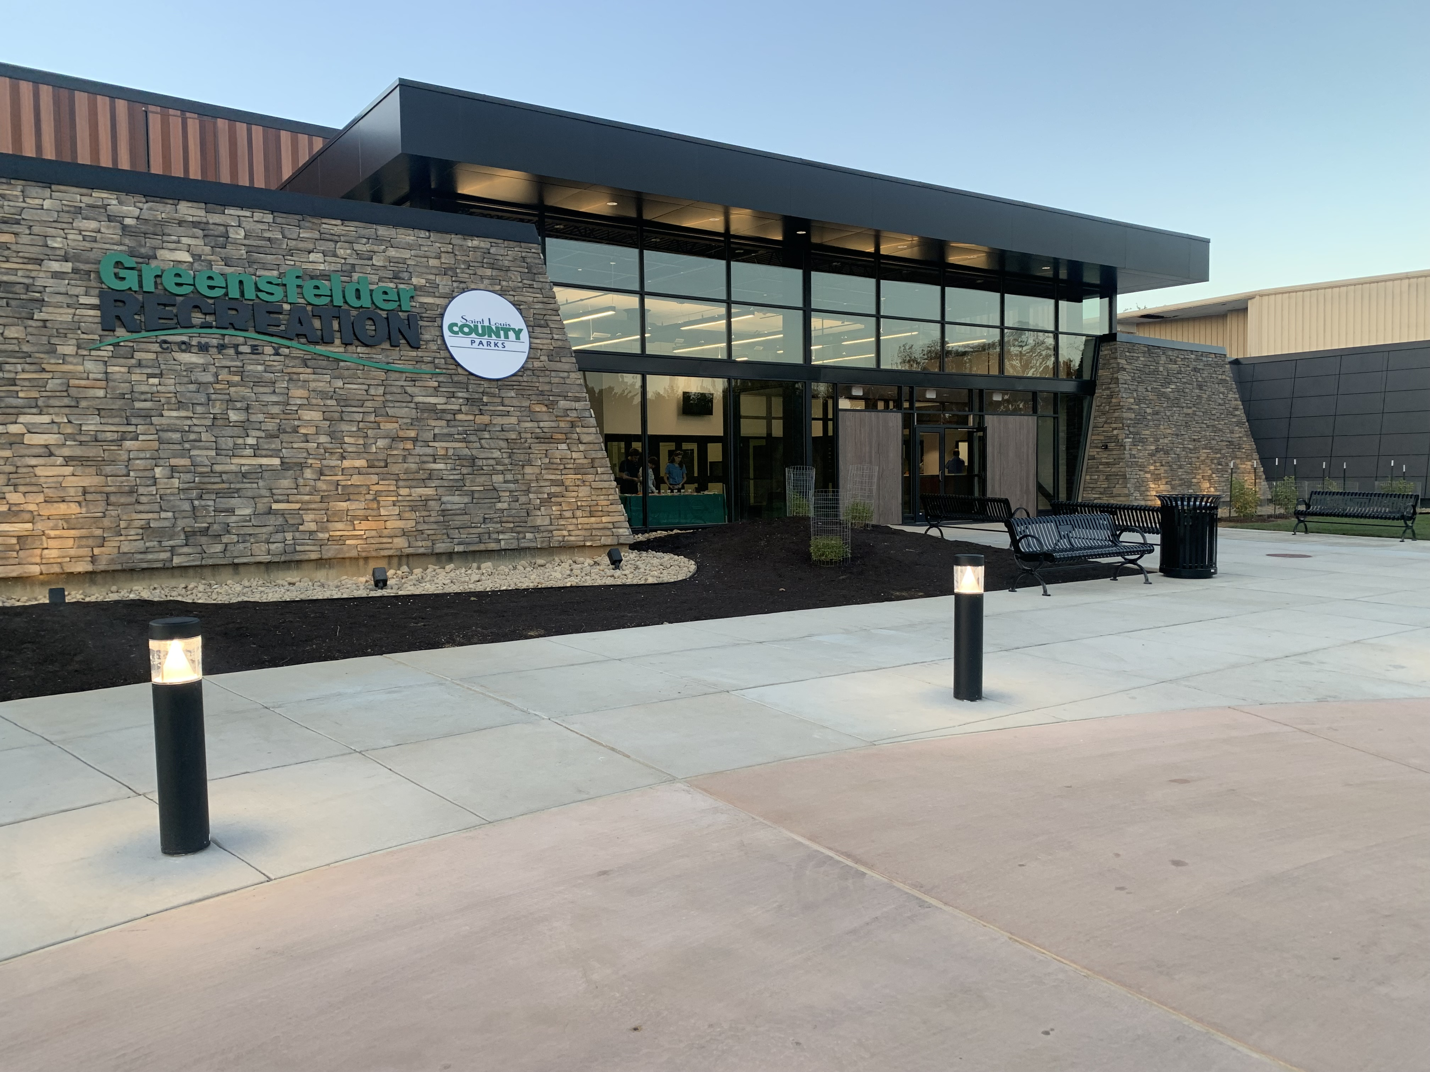
Reserve the Date…
We will be back in the Spring of 2025
Where: Greensfelder Recreation Center, Queeny Park
When: April 9th-13th, 2025

Slide 30
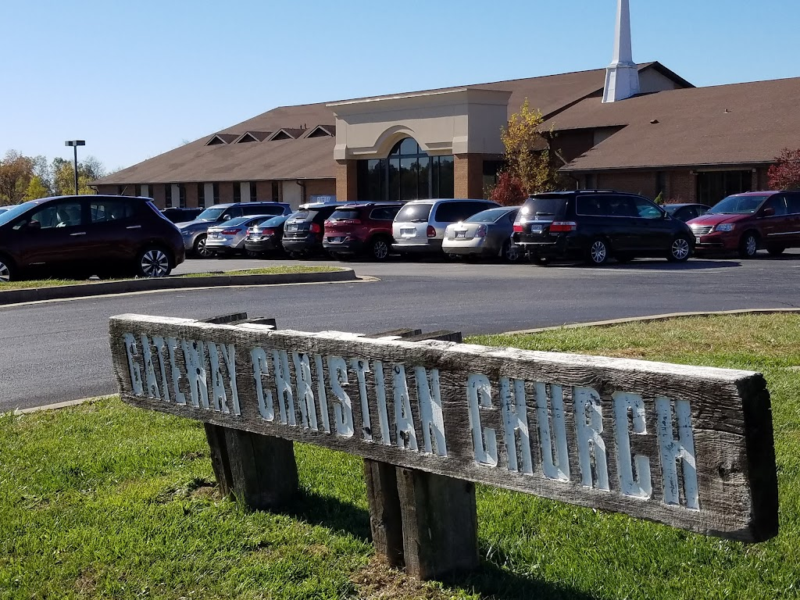
When is my next opportunity to pack in the St. Louis area?
Gateway Community Church
Fall of 2024
Date from Jenni

Slide 31
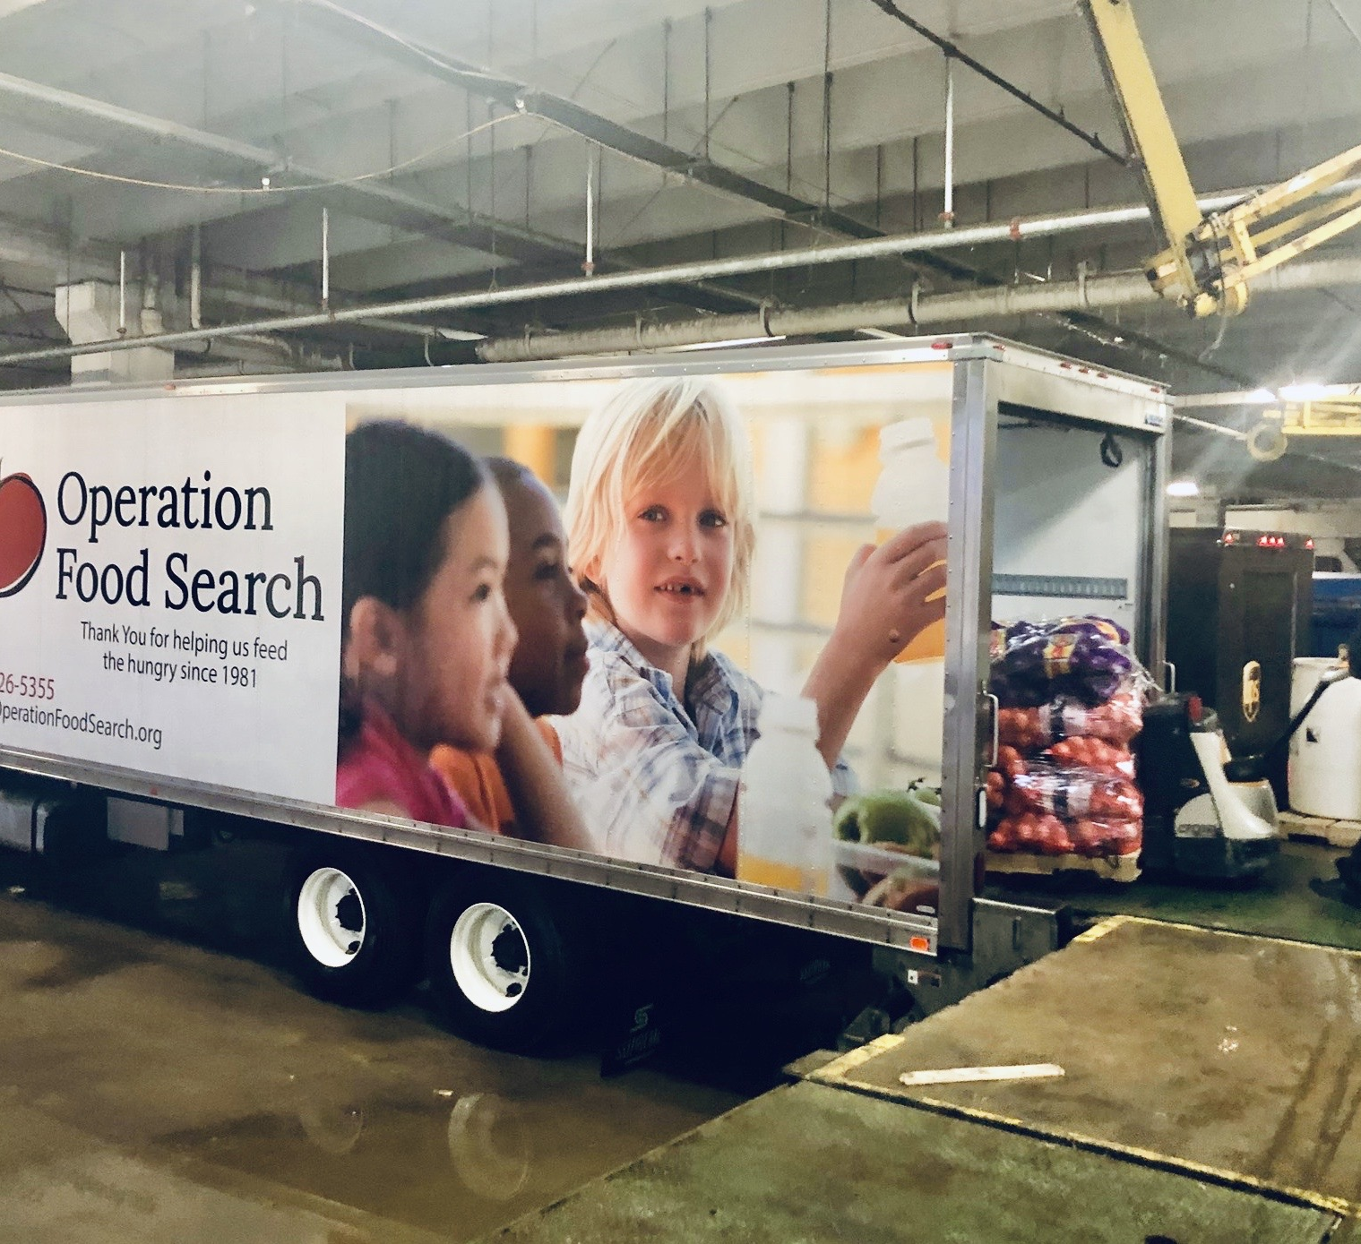
Thank you for your support of Operation Food Search!!
Feeding 115,000 daily in our community

Slide 32
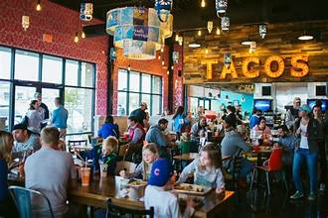
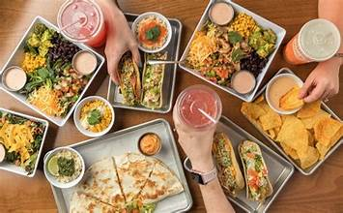
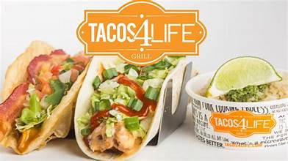
Special Thanks to our Premiere Sponsor Opening its next store soon on Manchester Rd

Slide 33
Remember it’s easy to donate, just scan and click!

Slide 34
Thank you for coming and feeding so many!!
FeedTheNeedSTL.org

